Slide 1
CCNA 200-301
Cloud Architecture

Slide 2
Objectives
Explain the role and function of network components
  Servers
Describe the characteristics of network topology architectures
  On-premises and cloud
Explain virtualization fundamentals (virtual machines)

Slide 3
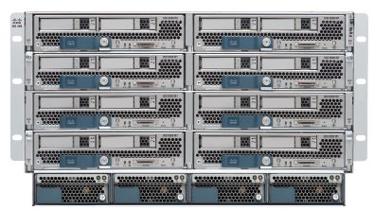
Cisco UCS Servers: B-Series (Blade)

Slide 4
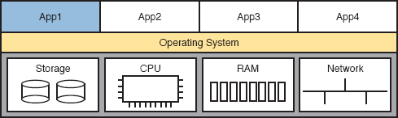
Physical Server Model: Physical Hardware, One OS, and Applications

Slide 5
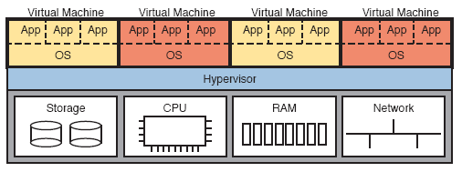
Four VMs Running on One Host; Hypervisor Manages the Hardware

Slide 6
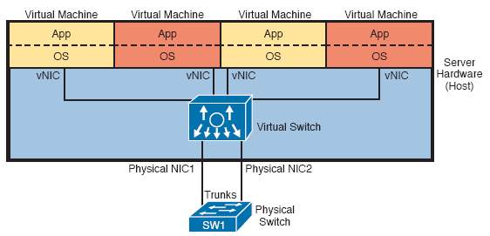
Basic Networking in a Virtualized Host with a Virtual Switch

Slide 7
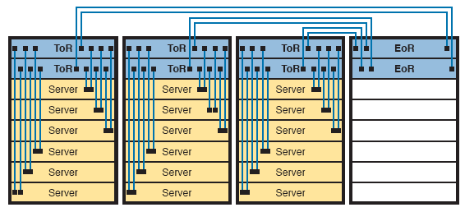
Traditional Data Center Top-of-Rack and End-of-Row Physical Switch Topology

Slide 8
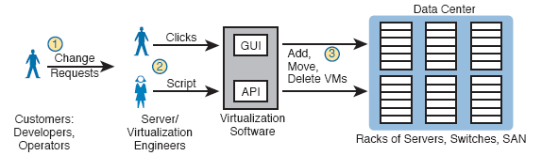
Traditional Workflow: Customer (Human) Asks Virtualization (Human) for Service

Slide 9
Cloud Computing Criteria
On-demand self-service
Broad network access
Resource pooling
Rapid elasticity
Measured service

Slide 10
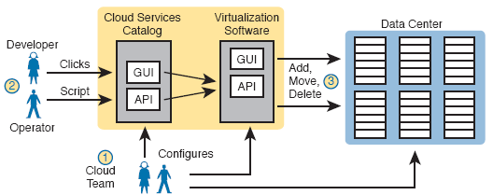
Basic Private Cloud Workflow to Create One VM

Slide 11
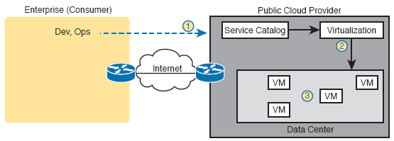
Public Cloud Provider in the Internet

Slide 12
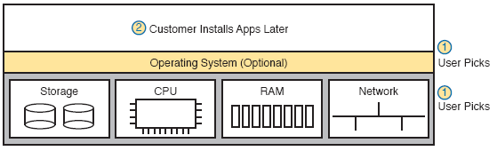
IaaS Concept

Slide 13
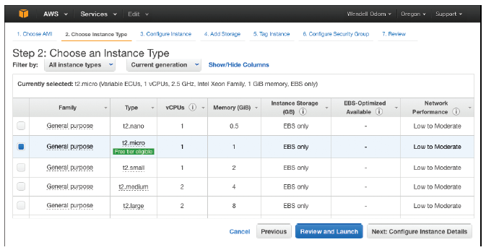
AWS Screenshot—Set Up VM with Different CPU/RAM/OS

Slide 14
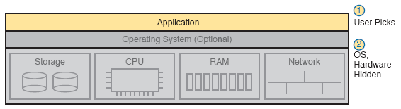
SaaS Concept

Slide 15
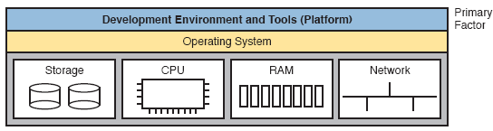
PaaS Concept

Slide 16
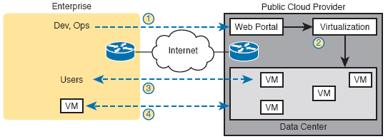
Accessing a Public Cloud Service Using the Internet

Slide 17
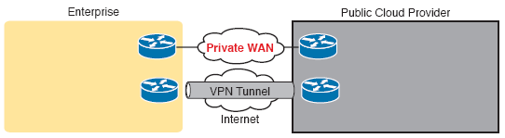
Using Private WAN to a Public Cloud: Security, QoS, Capacity, Reporting

Slide 18
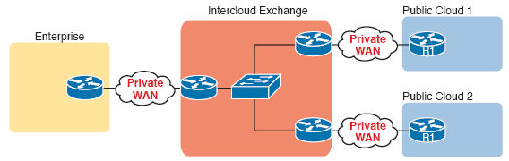
Permanent Private WAN Connection to an Intercloud Exchange

Slide 19
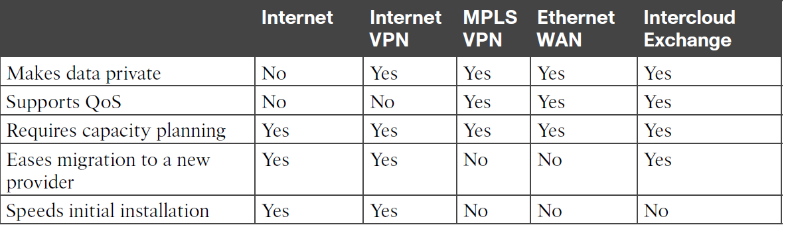
Comparison of Public Cloud WAN Options

Slide 20
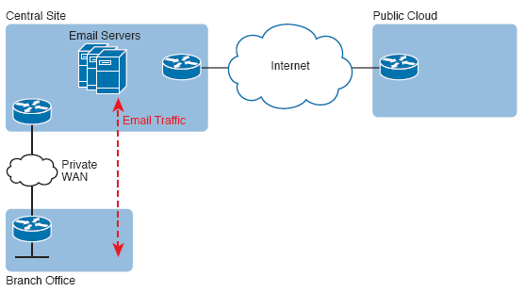
Traffic Flow: Private WAN, Enterprise Implements Email Services

Slide 21
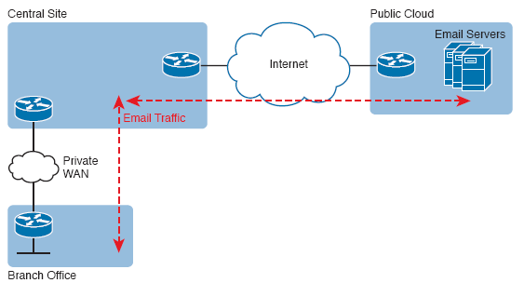
Traffic Flow: Private WAN, Enterprise Implements Email Services

Slide 22
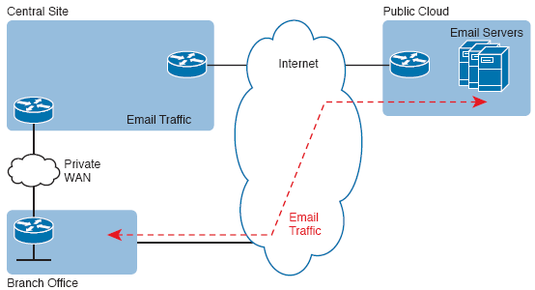
Connecting Branches Directly to the Internet for Public Cloud Traffic

